Slide 1
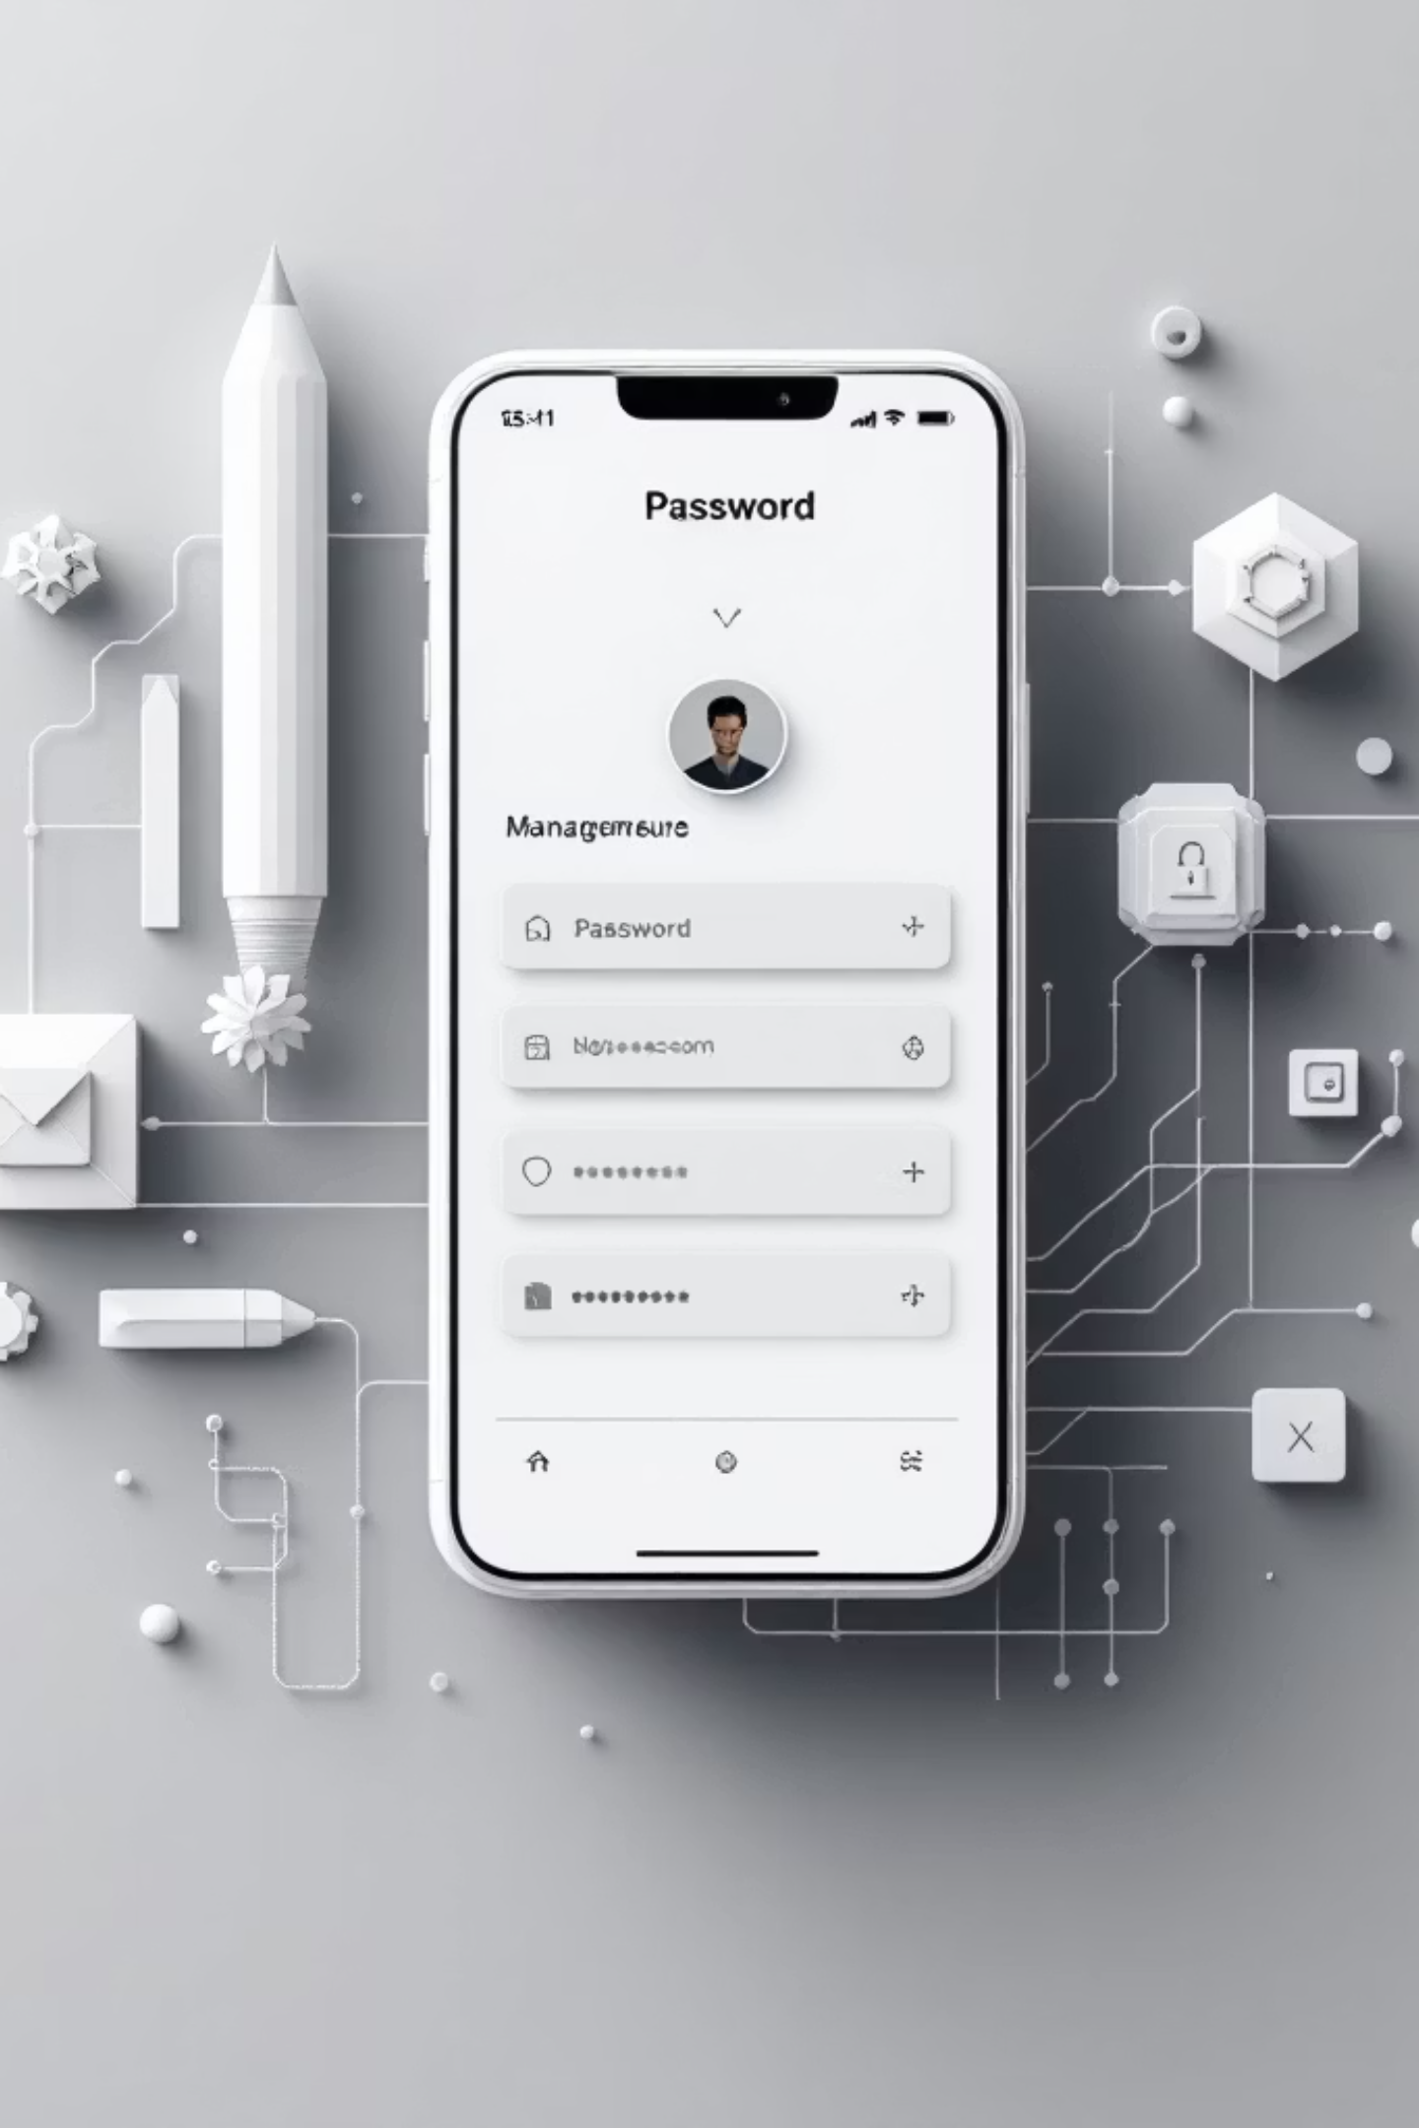



CredSentry: A Password Management Application
A Full-Stack Project for Learning Spring Boot
Presented by:
Harihara Sudan PS
Department: B.Tech IT | Reg No: 43120060

Slide 2



Introduction & Objectives
Project Introduction
Primary Objective
Integration Goal
CredSentry is a robust, full-stack application designed for secure password management.
To master and apply core principles of the Spring Boot Framework through hands-on development.
Successfully integrate a React frontend, Spring Boot backend, and MongoDB database.

Slide 3


The Solution: CredSentry
A user-friendly platform for securing digital identities.
Core Functionality
Straightforward Interface
Allows users to securely Save, View, Update, and Delete their sensitive login credentials.
Designed for simplicity and ease of use, centralizing all credential management tasks.

Slide 4




Key Features: CRUD Operations
C: Add (Create)
R: View (Read)
Secure forms to store new credentials (website URL, username, encrypted password).
Displays a complete, accessible list of all stored credentials for quick access.
U: Manage (Update)
D: Manage (Delete)
Functionality to edit and modify existing saved credentials when details change.
Secure option to permanently remove any credential records from the database.

Slide 5




The Three-Tier Stack
React (Frontend)
Interactive client UI
Three-Tier Architecture
MongoDB (Database)
Spring Boot (Backend)
Document data storage
REST APIs and business logic
Frontend: React (Vite)
Backend: Spring Boot
Database: MongoDB
Interactive and responsive User Interface (UI) built with modern JavaScript library.
The core application layer. Provides RESTful APIs and handles business logic.
Flexible NoSQL document storage for managing dynamic credential data structures.

Slide 6
System Workflow & Validation
User Interaction
Action triggered on the React frontend (e.g., "Save Credential").
API Call
Frontend initiates a request (e.g., POST, GET) to the Spring Boot REST API endpoint.
Backend Processing
Spring Boot processes the request, handles security, and executes the business logic.
Database I/O
Data is securely retrieved or persisted in the MongoDB instance.

Slide 7
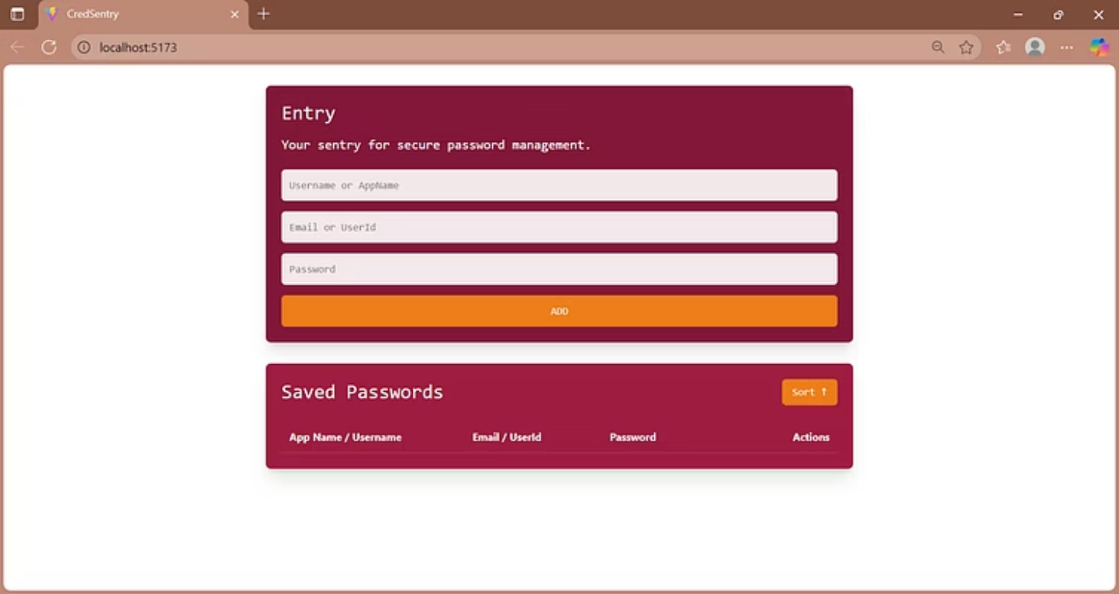
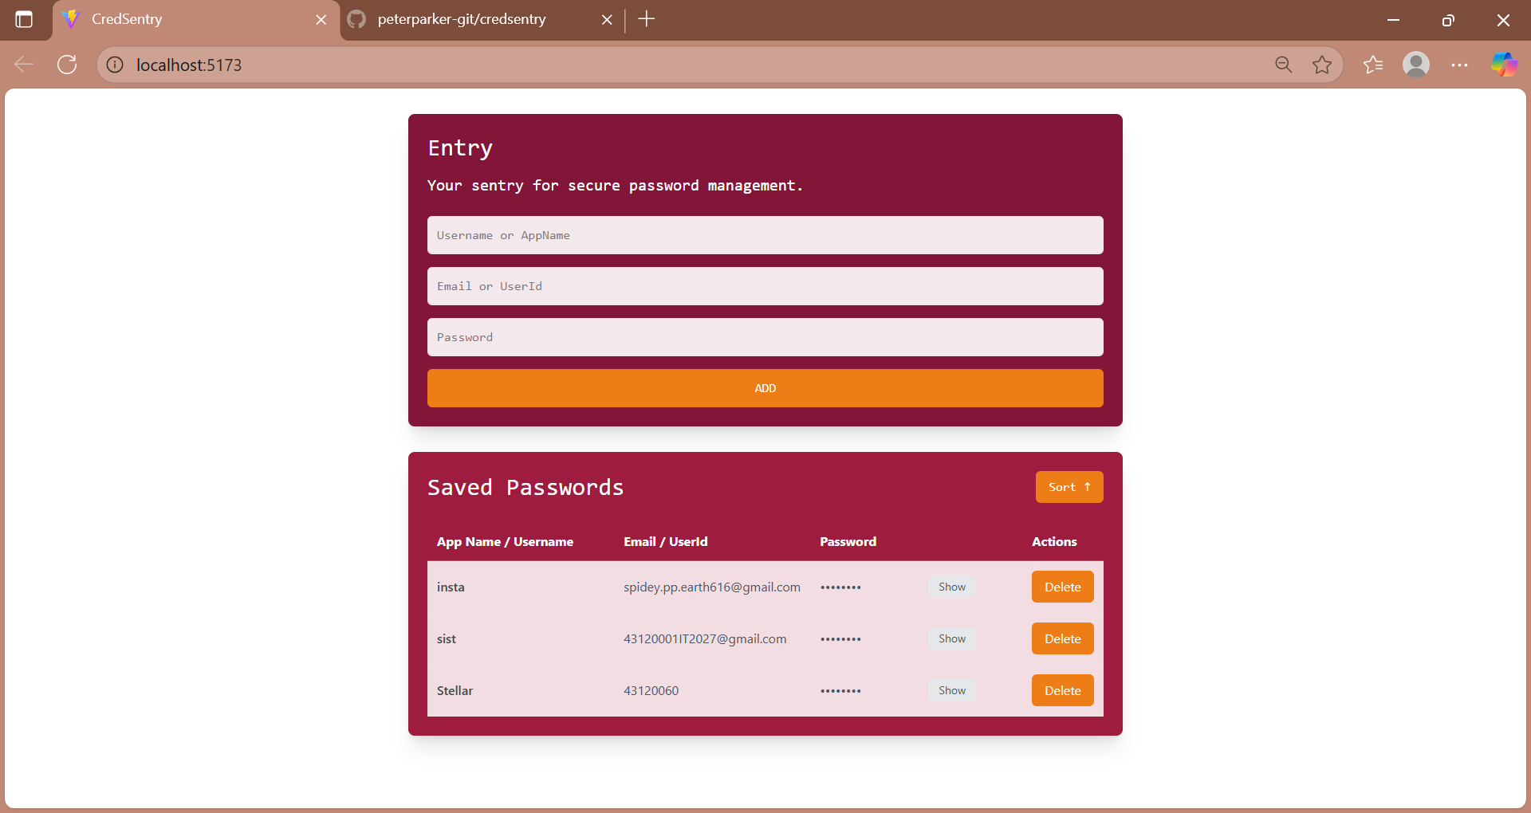
Application Visual Demo
A glimpse into the CredSentry user interface.
Left: The primary view displaying the list of saved credentials. Right: The modal used for inputting new login details.

Slide 8
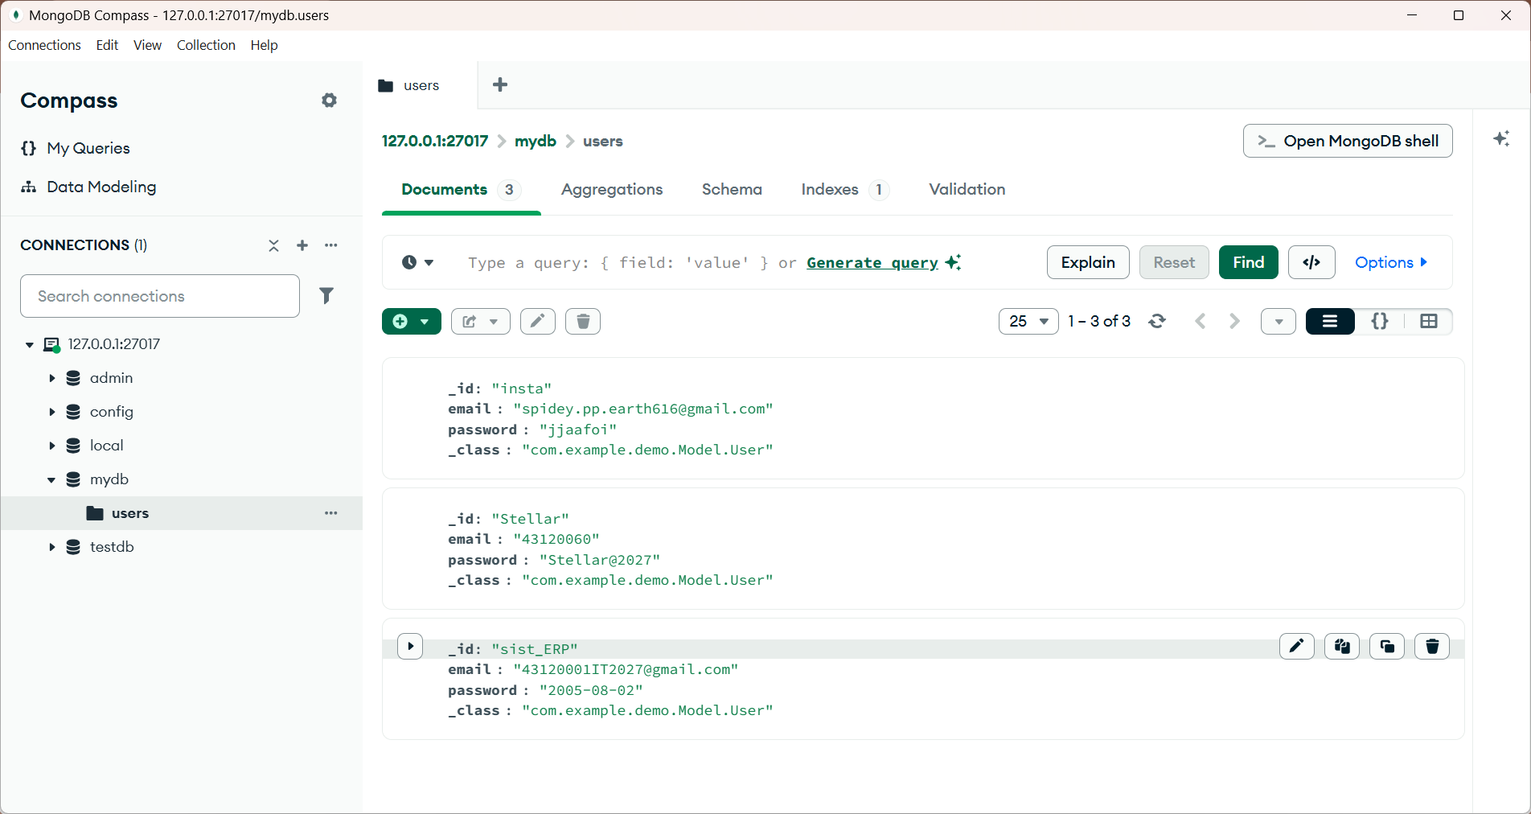
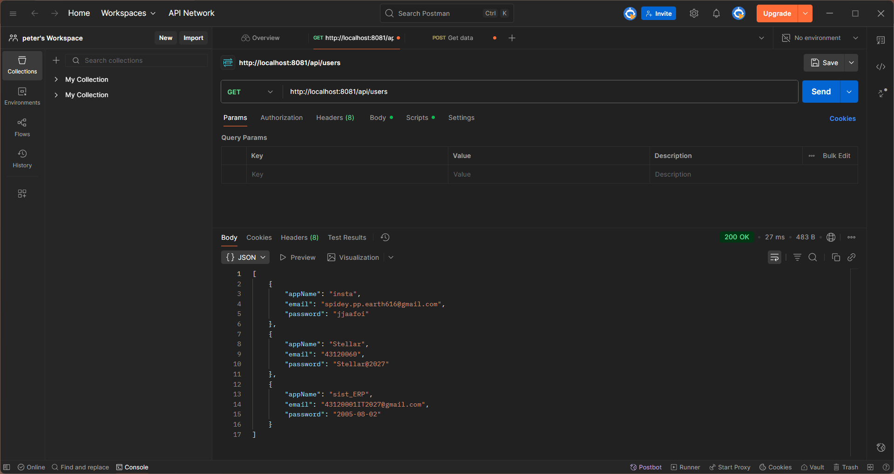
Backend Process
Left: List of saved credentials in MongoDB. Right: Tested data for Postman API.

Slide 9
Key Learnings & Future Scope
Spring Boot Mastery
Future Enhancements
Project setup & dependency injection.
Add user login and management.
Developing REST controllers (CRUD operations).
Implement "Copy to Clipboard" feature.
Implementing Spring Data MongoDB.
Integrate search and filter for credentials.
Understanding API endpoint design.

Slide 10

Thank You

